Slide 1
Setting up the project

Slide 2
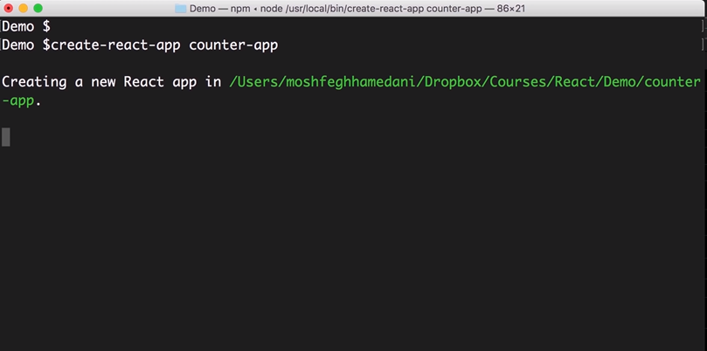

Slide 3
creating a new project from the terminal or command prompt
let's run create-react-app and give our application a name counter–app

Slide 5
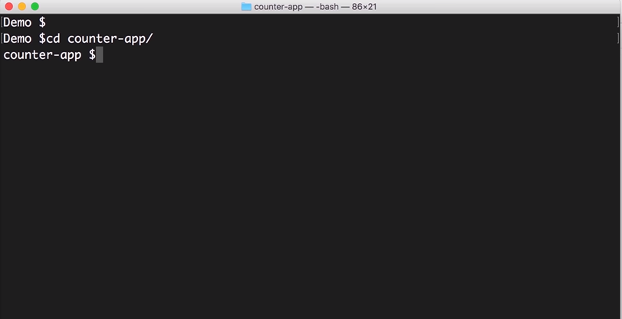

Slide 6
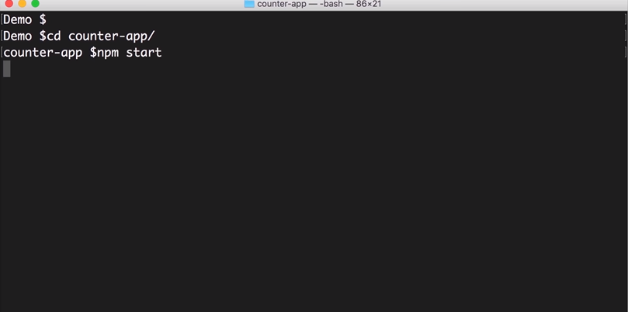

Slide 7
go to this folder counter app
and start the application

Slide 8
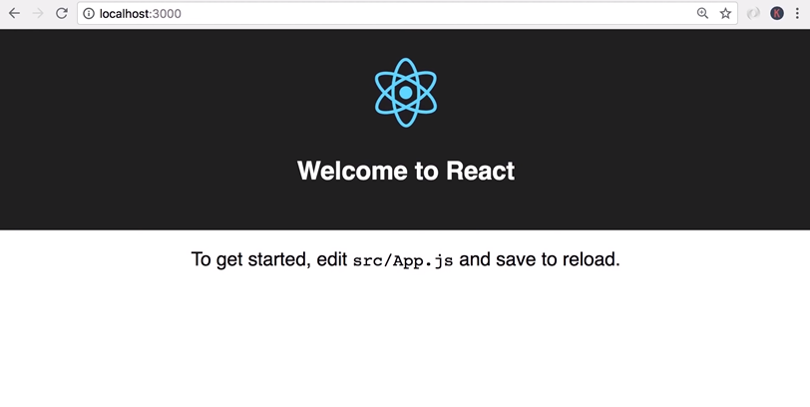

Slide 9
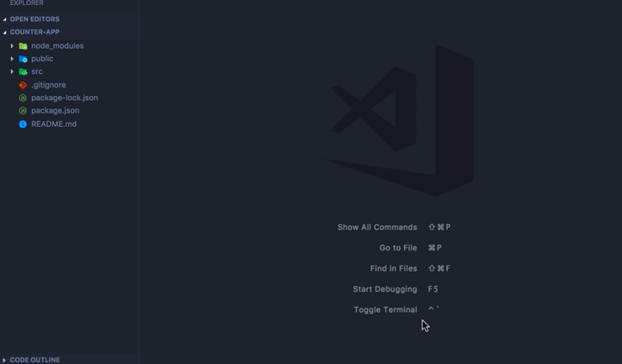

Slide 10
now here in vs code the first thing we need to do is install bootstrap
in case you are not familiar with bootstrap it's basically a CSS library that gives our applications a modern look and feel
To install bootstrap we need to go back in terminal
but if you look here in vs code we have this shortcut toggle terminal on Mac the shortcut is ctrl+ backtick

Slide 11
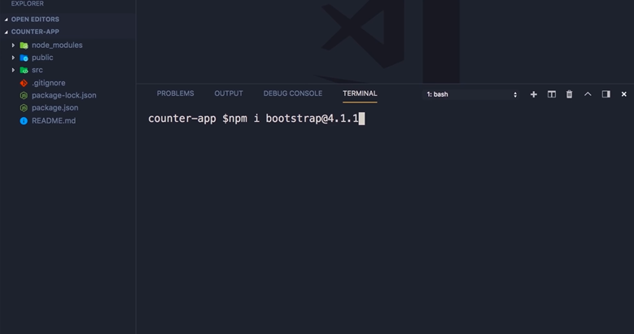

Slide 12
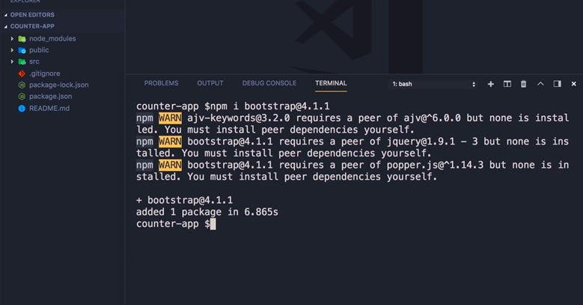

Slide 13
so let's open that up here so here we have an integrated terminal we can run NPM install bootstrap make sure to install the same version I'm gonna install in this video so version 4.1.1

Slide 14
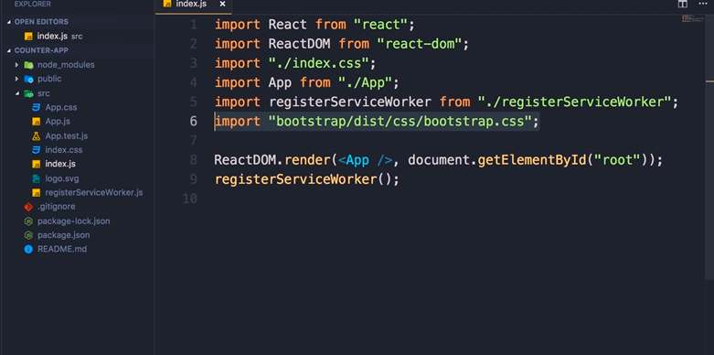

Slide 15
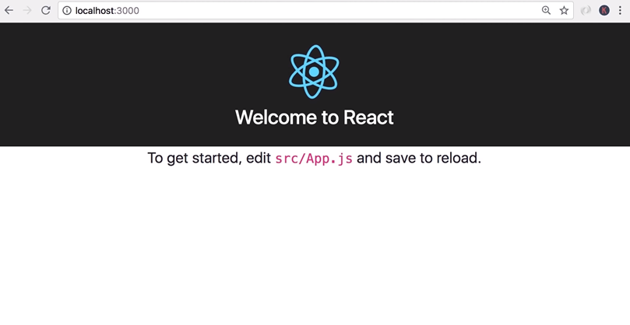

Slide 16
finally we need to import this in index.js
save the changes back in the browser you can see the font is changed

